Slide 1
REST APIs - Introduction
Sep 2025

Slide 2
REST APIs - introduction
What we learn today:
What these words mean:
HTTP
API
REST
How applications are used on the Internet
What is happening on the network
Prerequisites:
Chrome browser
Notes:
This is just an explanation of what is going on, all this complexity is hidden by python libraries. Like the discussion on what happens when we return from a function. Today we learn about what things exist because we use them in our programs.

Slide 3
What is an API? - Application Programming Interface
API stands for - Application Programming Interface
You can make any application available for other programs
How? You define an API for the application

Slide 4
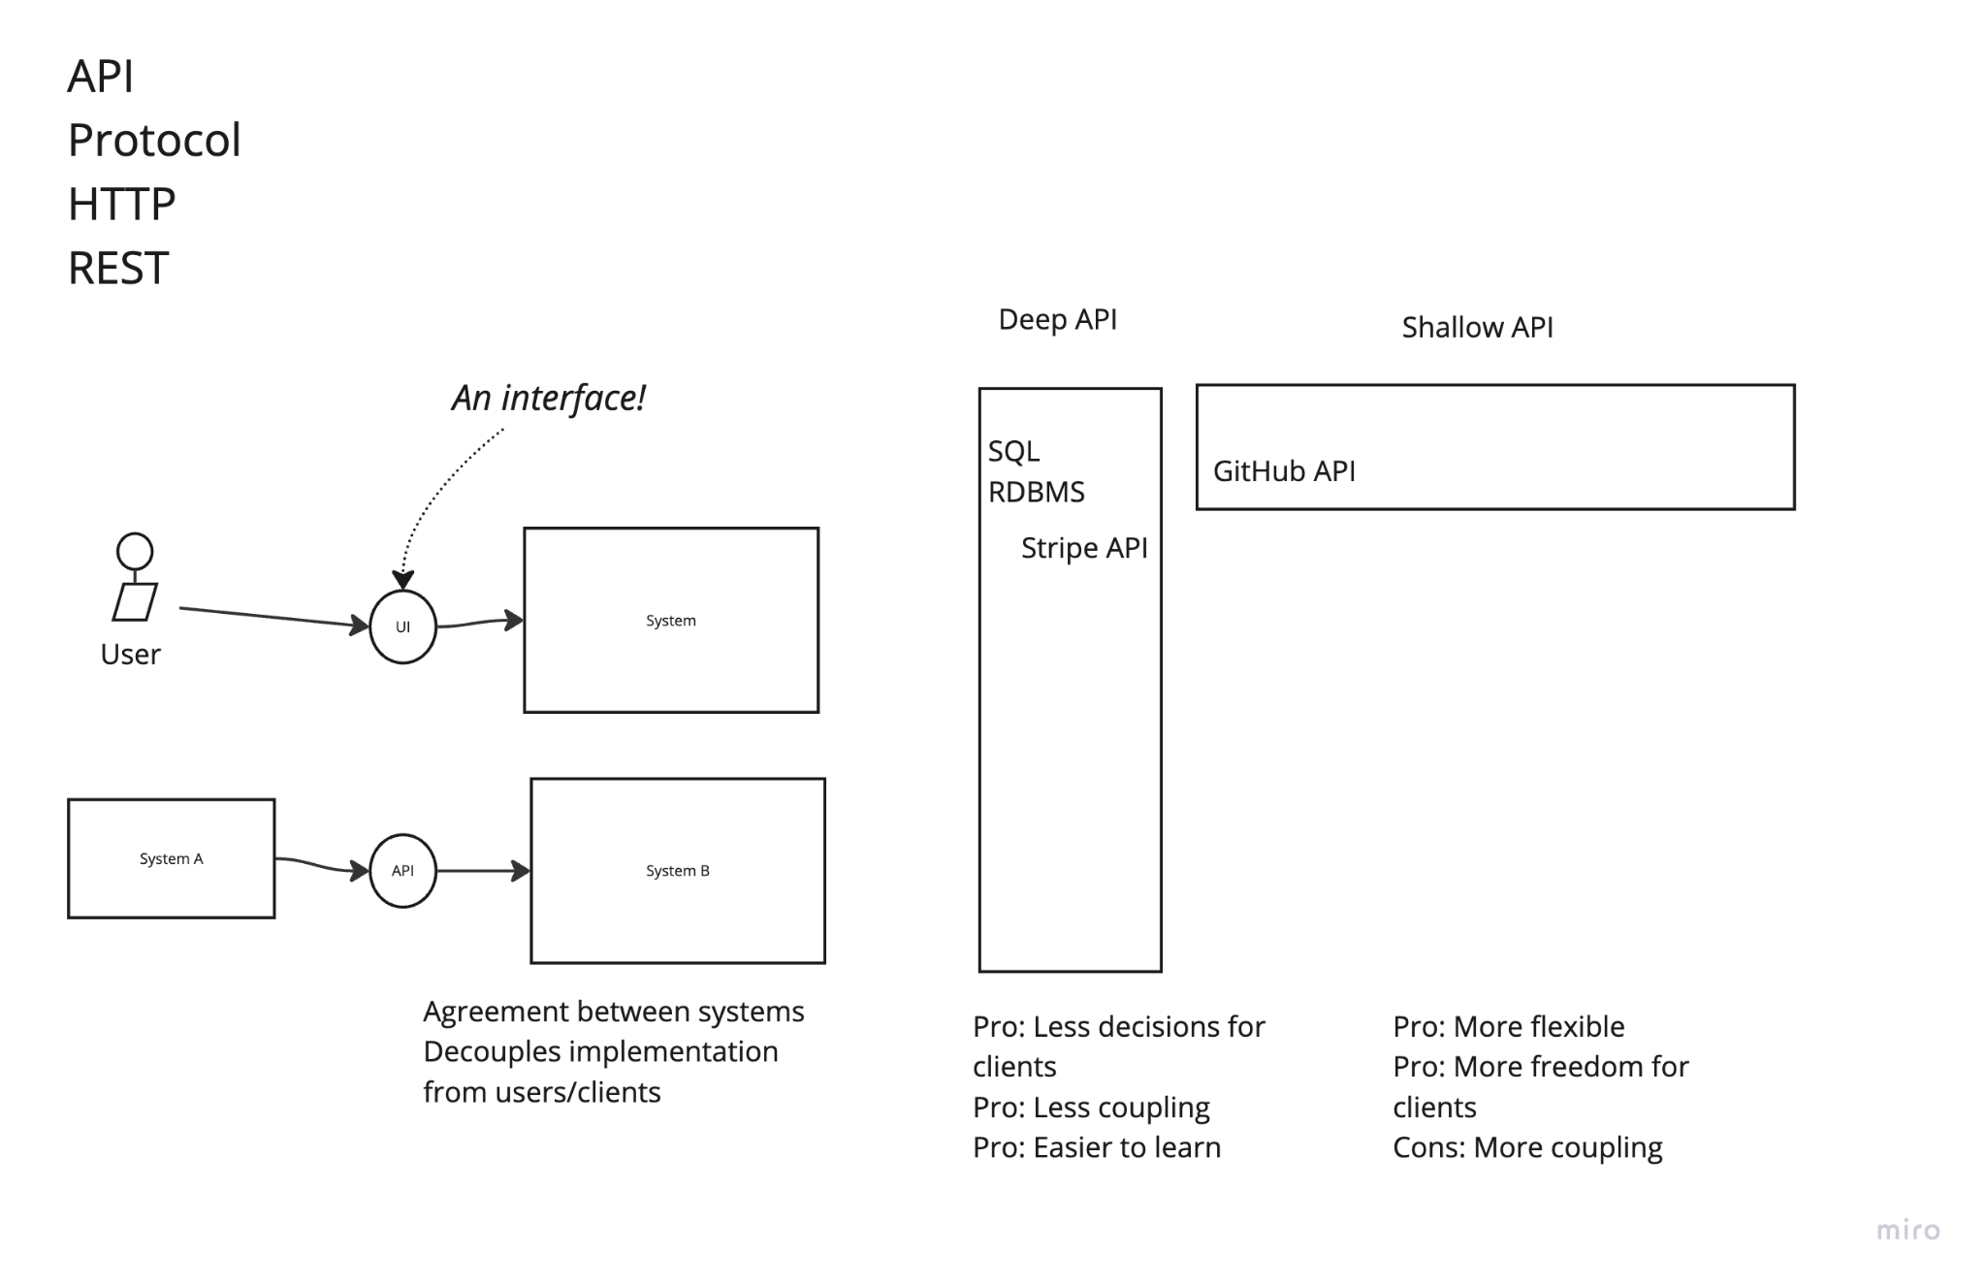

Slide 5
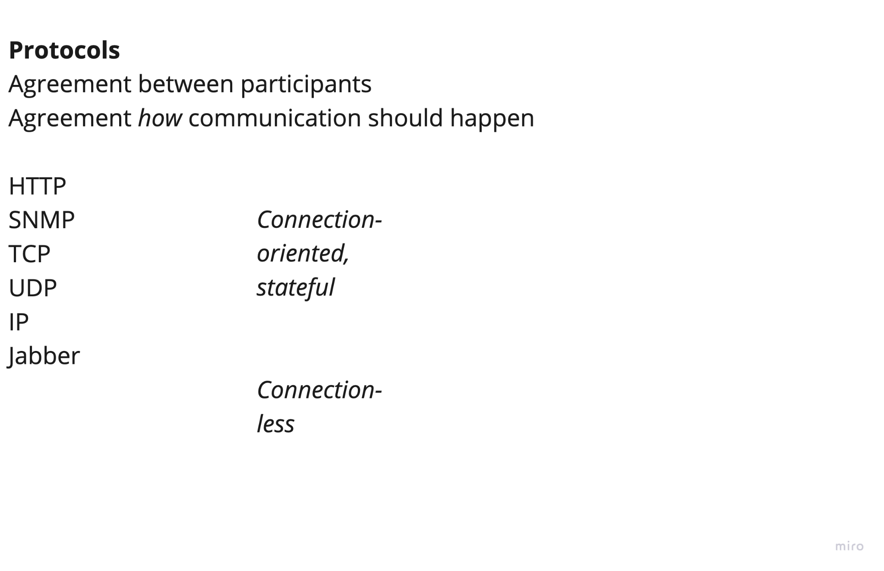

Slide 6
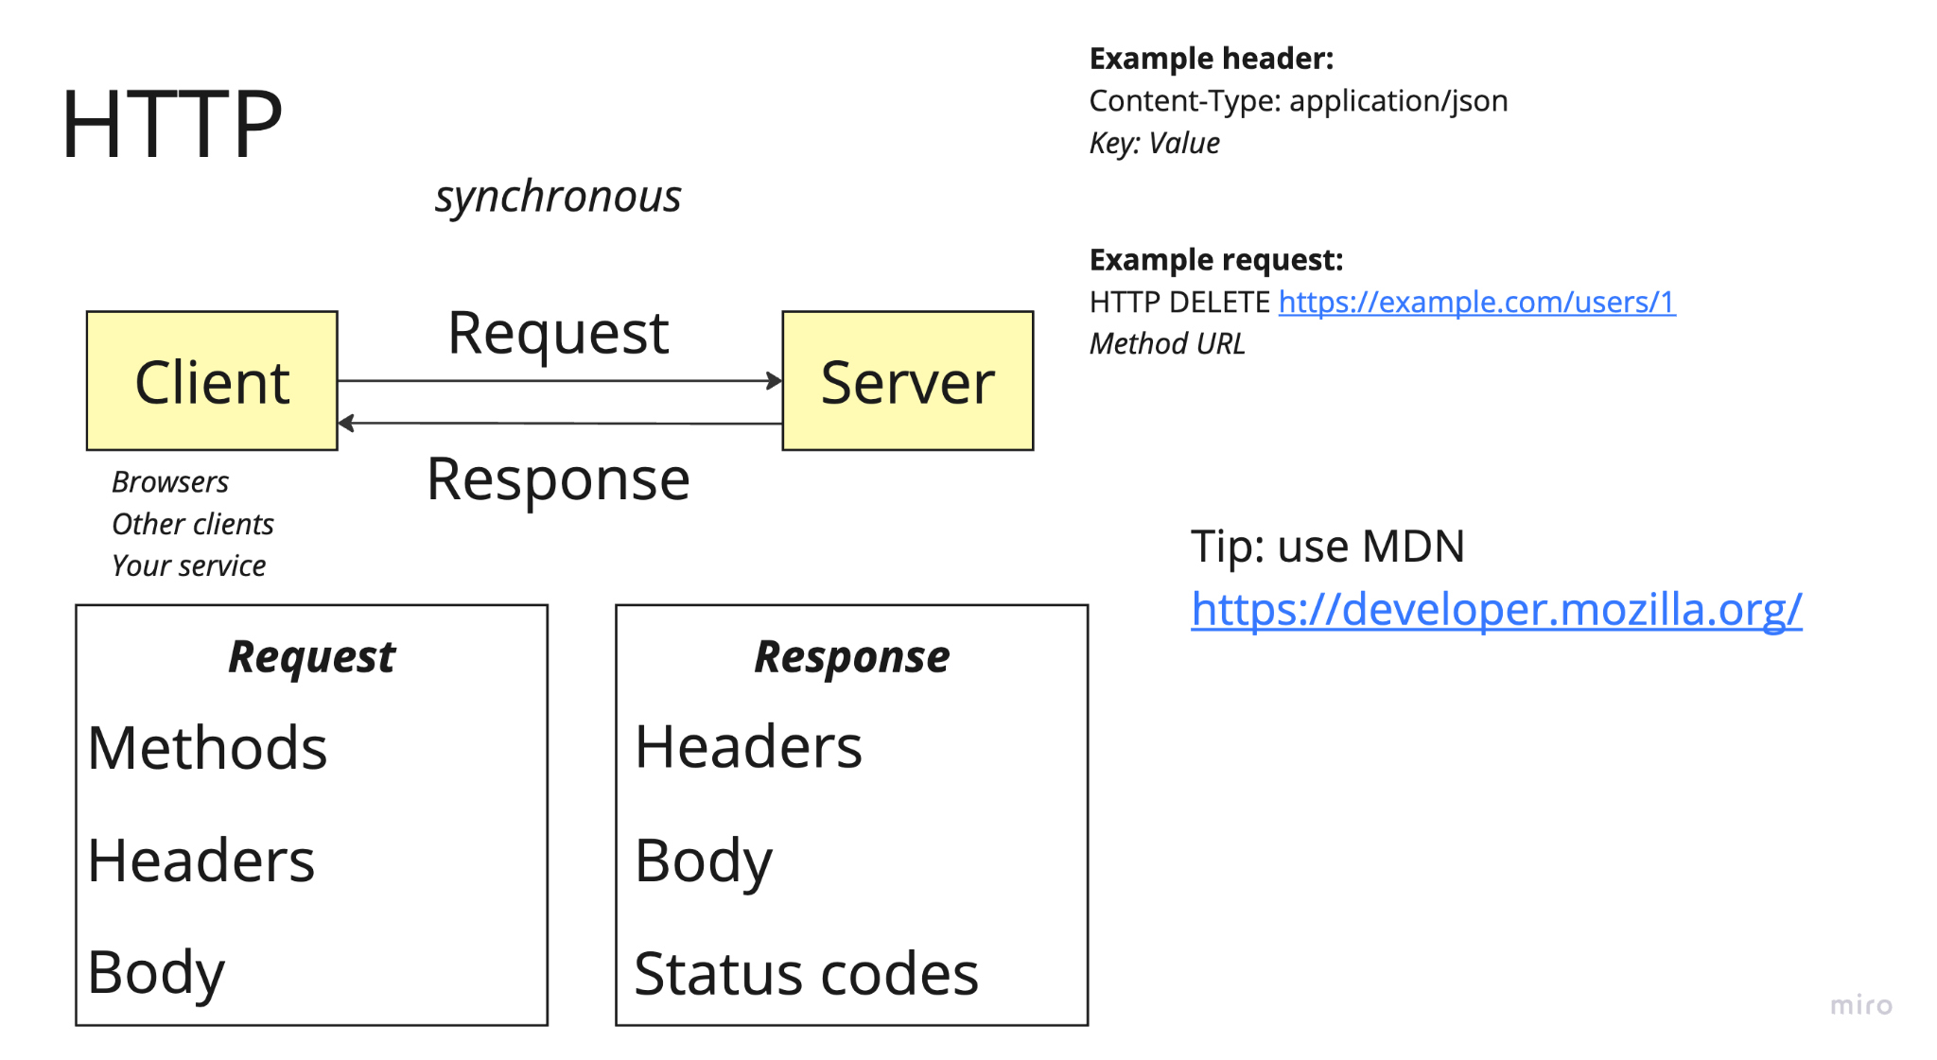

Slide 7
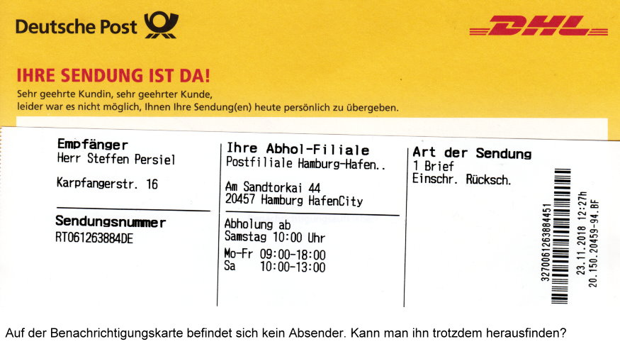
What is HTTP? - A letter for the Internet
Headers - think about a letter envelope
Contains information such as:
Address for both receiver and sender
Names of the sender and receiver
Stamps
Body - the contents of a letter
Contains the information that you actually want to send

Slide 8
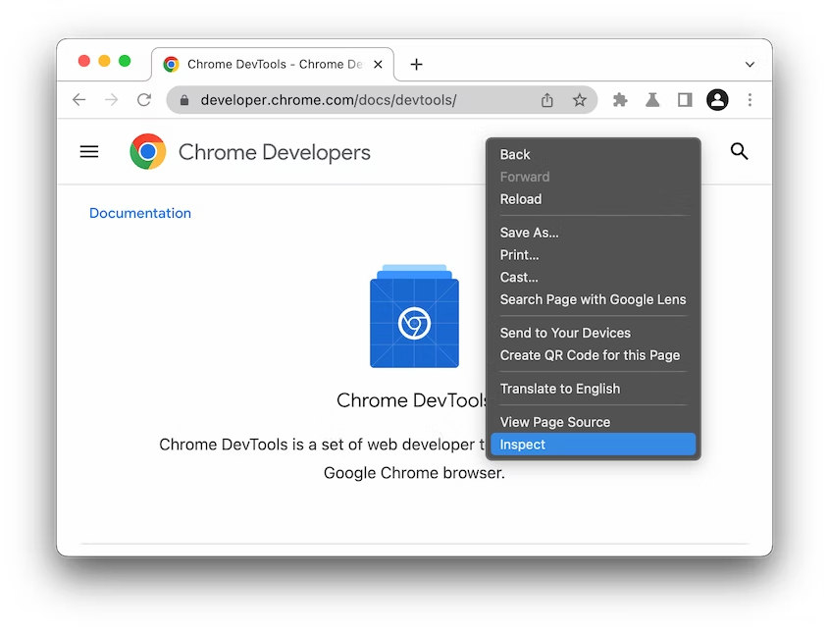
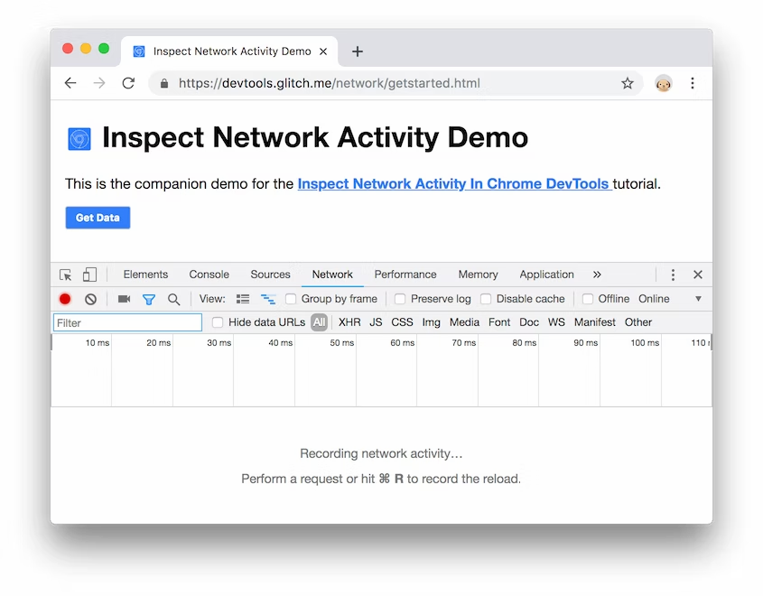
The setup
Open up Chrome with a new tab
Right click on the start page -> Inspect
Navigate to the ‘Network’ tab
Tutorial at: https://developer.chrome.com/docs/devtools/network/

Slide 9
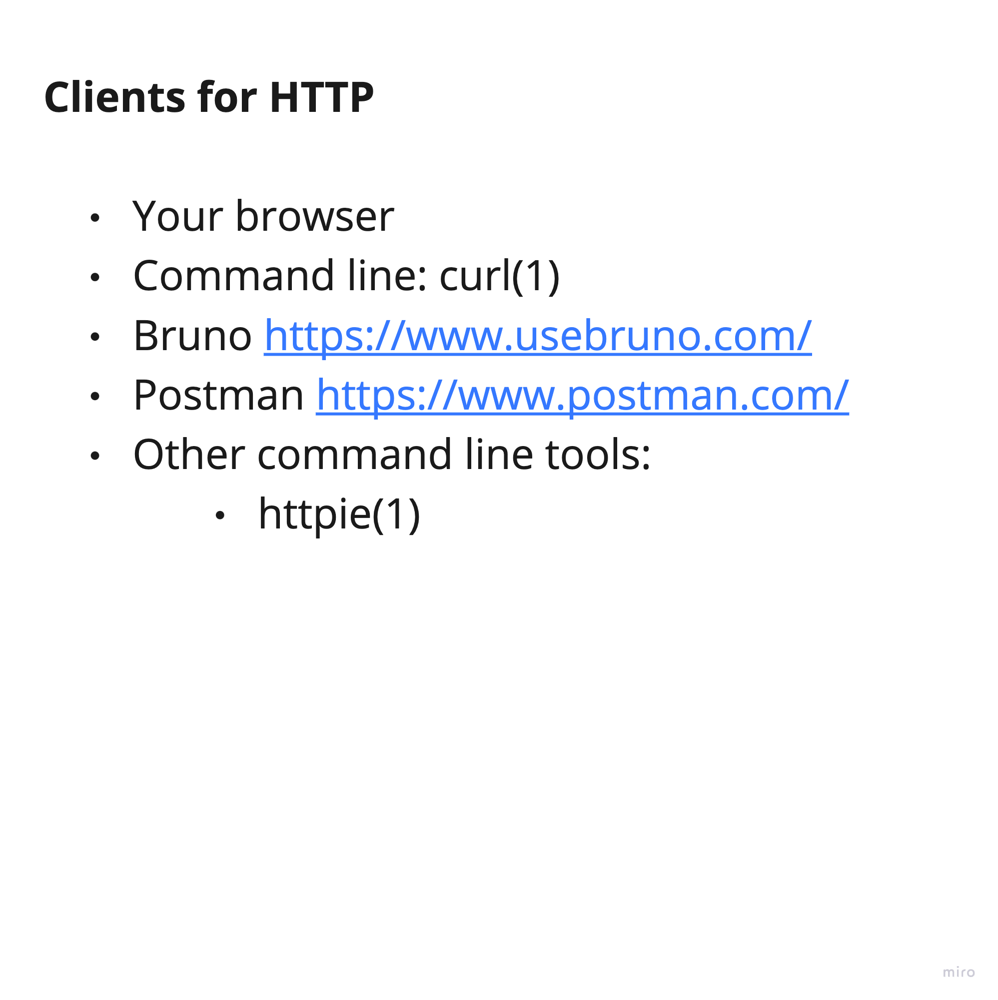

Slide 10
What is an API and why do I care?
One way to view it is like converting an application into a library
Other people can just import your API and then call methods to control it
Frontend and Backend can communicate via APIs
When you make a new component, just define an API and everyone can use it (like a python library!)

Slide 11
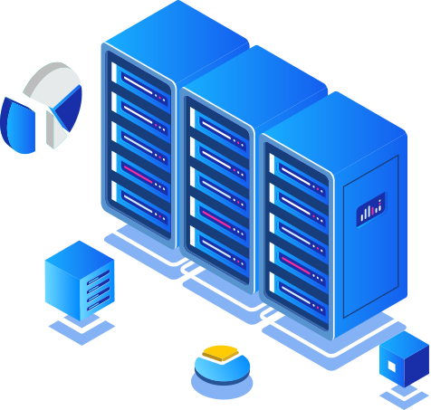

HTTP is a network protocol
When you send a letter you follow a protocol - a series of steps and rules - it is the same with HTTP
Important headers you need to write (like the address and name on a letter):
Hostname
Content type
Status code
Important status code categories:
200: Success
400: Client error - the client is making a wrong request
500: Server error - the server has a problem
client
server
https://developer.mozilla.org/en-US/docs/Web/HTTP/Status

Slide 12
HTTP messages
POST /redi/shop HTTP/1.1
Host: redi-school.org
Accept: application/json
Content-Type: application/json
Content-Length: 81
{
"Id": 78912,
"Customer": "Redi School",
"Quantity": 1,
"Price": 18.00
}
GET /hello.htm HTTP/1.1
User-Agent: Mozilla/4.0
Host: www.tutorialspoint.com
Accept-Encoding: gzip, deflate
Connection: Keep-Alive
https://www.restapitutorial.com/lessons/httpmethods.html
https://developer.mozilla.org/en-US/docs/Web/HTTP/Messages

Slide 13
What is REST? - https://www.restapitutorial.com/
The problem: the Internet was pure chaos, everyone made their own APIs and did whatever they wanted, so the apps were difficult to use.
The solution: make a standard for everyone to follow!
REST - was accepted as the standard of communication for web applications. It is a set of rules that you use when creating your API.
REST is usually using HTTP as underlying protocol.
So REST is like: how to write APIs using HTTP

Slide 14
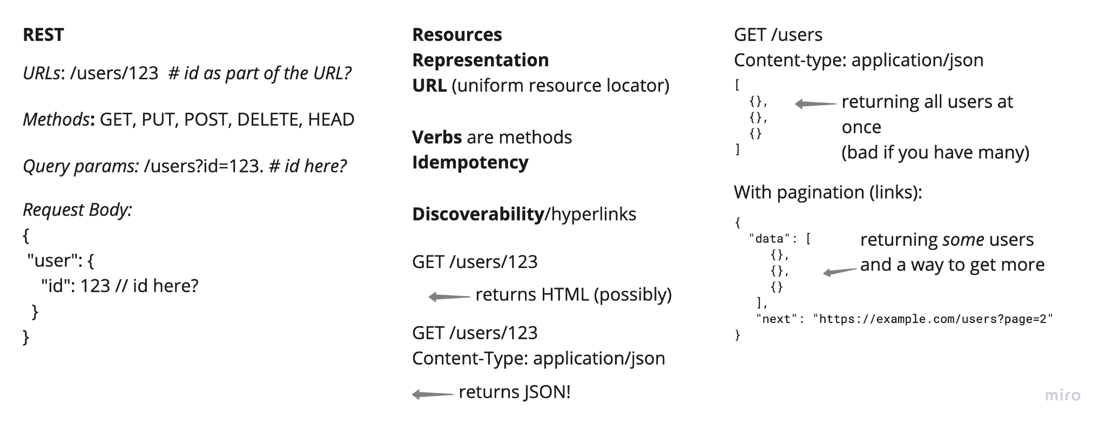

Slide 15
REST - How it works
Uses the HTTP verbs to define actions:
GET: Get a resource
POST: Create a resource
PUT: Update a resource
DELETE: Remove a resource
Creates a representation of our system in the body and headers of the HTTP messages

Slide 16
REST - What is a representation?
HTTP gives us standard methods and status codes everyone uses, but what about the body of the messages?
With REST we use a standard format for the messages such as JSON or XML

Slide 17
REST - What is a representation?
HTTP gives us standard methods and status codes everyone uses, but what about the body of the messages?
With REST we use a standard format for the messages such as JSON or XML
Request
GET https://cat-fact.herokuapp.com/facts/
Status: 200 OK
{
"source": "user",
"text": "Cats make about 100 different sounds. Dogs make only about 10.",
"createdAt": "2018-01-15T21:20:00.003Z",
},
{
"source": "user",
"text": "Domestic cats spend about 70 percent of the day sleeping and 15 percent of the day grooming.",
"createdAt": "2018-01-14T21:20:02.750Z",
}
Response

Slide 18
Live experiments
Let's look at some websites to see what is going on between our browser and the server.
Open the networking tab in Chrome developer tools and visit these websites
https://cat-fact.herokuapp.com/facts/
https://www.anapioficeandfire.com/api/characters
https://www.anapioficeandfire.com/api/books
https://www.anapioficeandfire.com/api/house
https://www.postman.com/cs-demo/workspace/public-rest-apis/collection/8854915-454a2dc7-dcbe-41cf-9bfa-da544fcd93a2?ctx=documentation
(you need a postman account to use the collection)
Optionally you can install this extension to view the JSON better: https://chrome.google.com/webstore/detail/json-viewer/gbmdgpbipfallnflgajpaliibnhdgobh

Slide 19
Making our own server
$ cat server.py
from fastapi import FastAPI, Request, Response
app = FastAPI()
@app.get("/users/{item_id}")
def get_user(item_id: int, response: Response):
response.status_code = 200
return {
"name": "John Doe",
"user_id": item_id
}
Flask
FastAPI
Example:
https://fastapi.tiangolo.com/#installation
Play with this!

Slide 20
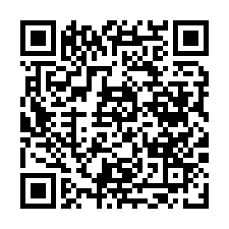
Before you go…
Please take 2 minutes to give us feedback on today’s lesson.
This feedback is anonymous and only seen by the DCP team!
Scan the QR code or go to: https://redischool.typeform.com/lessonfeedback

